Slide 1

Research

Slide 2
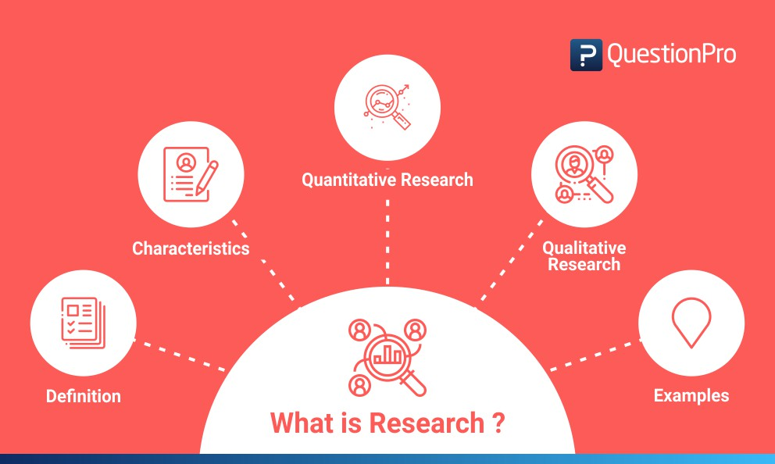
What is Research
“Research is a systematic inquiry to describe, explain, predict, and control the observed phenomenon. It involves inductive and deductive methods.”
Earl Robert Babbie

Slide 3
Reasons for Research
Identify
Identify potential and new customers
Understand
Understand existing customers
Set
Set pragmatic goals
Develop
Develop productive market strategies
Address
Address business challenges
Plan
Put together a business expansion plan
Opportunities
Identify new business opportunities

Slide 4
Purpose of Research
Exploratory Research
Descriptive Research
Explanatory Research
Use of multiple questions to examine an occurrence. It is undertaken to handle new problem areas that haven’t been explored before
Expanding knowledge on a current issue or topic. 3 primary purposes are describing, explaining, and validating.
Understanding the impact of specific changes in existing standard procedures. Running experiments is the most popular form.

Slide 5

Research Writing
“The physical process of gathering information + the mental process of deriving the answer to your question from the information you gathered”
“The process of sharing the answer to your research question along with the evidence on which your answer is based, the sources you used, and your own reasoning and explanation.”
Writing a research paper follows similar a standard composition essay – title, introduction, body, & conclusion.

Slide 6

Topic Selection
It must be narrow and focused enough to be interesting, yet broad enough to find adequate information. Narrow your topic to something manageable.
If your topic is too broad, you will find too much information and not be able to focus.
Background reading can help you choose and limit the scope of your topic.
Pick a topic that interests you – you will be researching, reading and writing about this topic for weeks. Therefore, choose something that will hold your interest
Brainstorming is a technique you can use to help you generate ideas.
Refer to lecture notes and required texts to refresh your knowledge of the course and assignment.
Talk about research ideas with a friend. S/he may be able to help focus your topic by discussing issues that didn't occur to you at first.
Think of the who, what, when, where and why questions:
WHY did you choose the topic? What interests you about it? Do you have an opinion about the issues involved?
WHO are the information providers on this topic? Who might publish information about it? Who is affected by the topic? Do you know of organizations or institutions affiliated with the topic?
WHAT are the major questions for this topic? Is there a debate about the topic? Are there a range of issues and viewpoints to consider?
WHERE is your topic important: at the local, national or international level? Are there specific places affected by the topic?
WHEN is/was your topic important? Is it a current event or an historical issue? Do you want to compare your topic by time periods?

Slide 7
Structure of a Research papers
Cover Page
Outline
Introduction
Body: 1-2 Heading Levels points introducing paragraph with Topic sentences
Paragraph development support facts. [Types of facts]
Visual Aid support where necessary
Conclusion
Complete Reference List of sources used
Thesis
Table of Contents

Slide 8
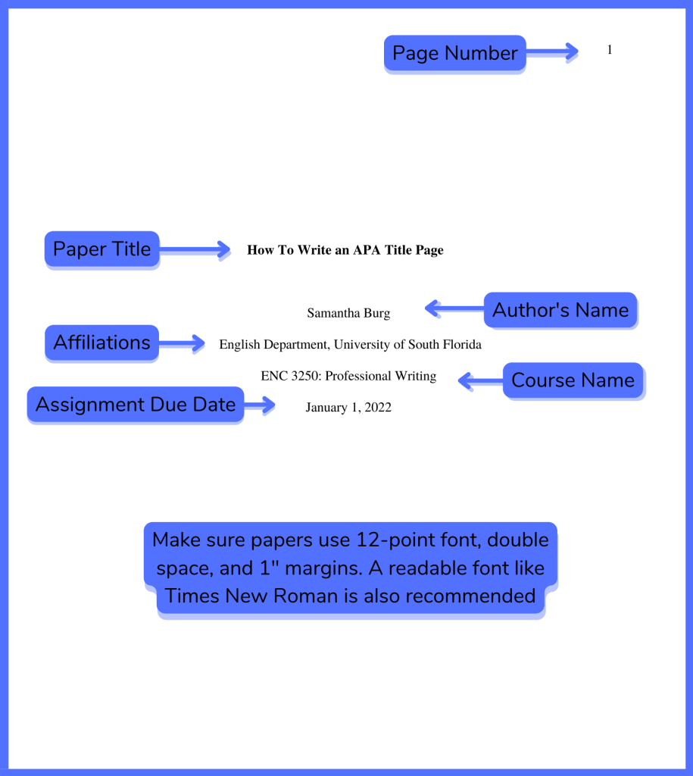
Cover Page

Slide 9
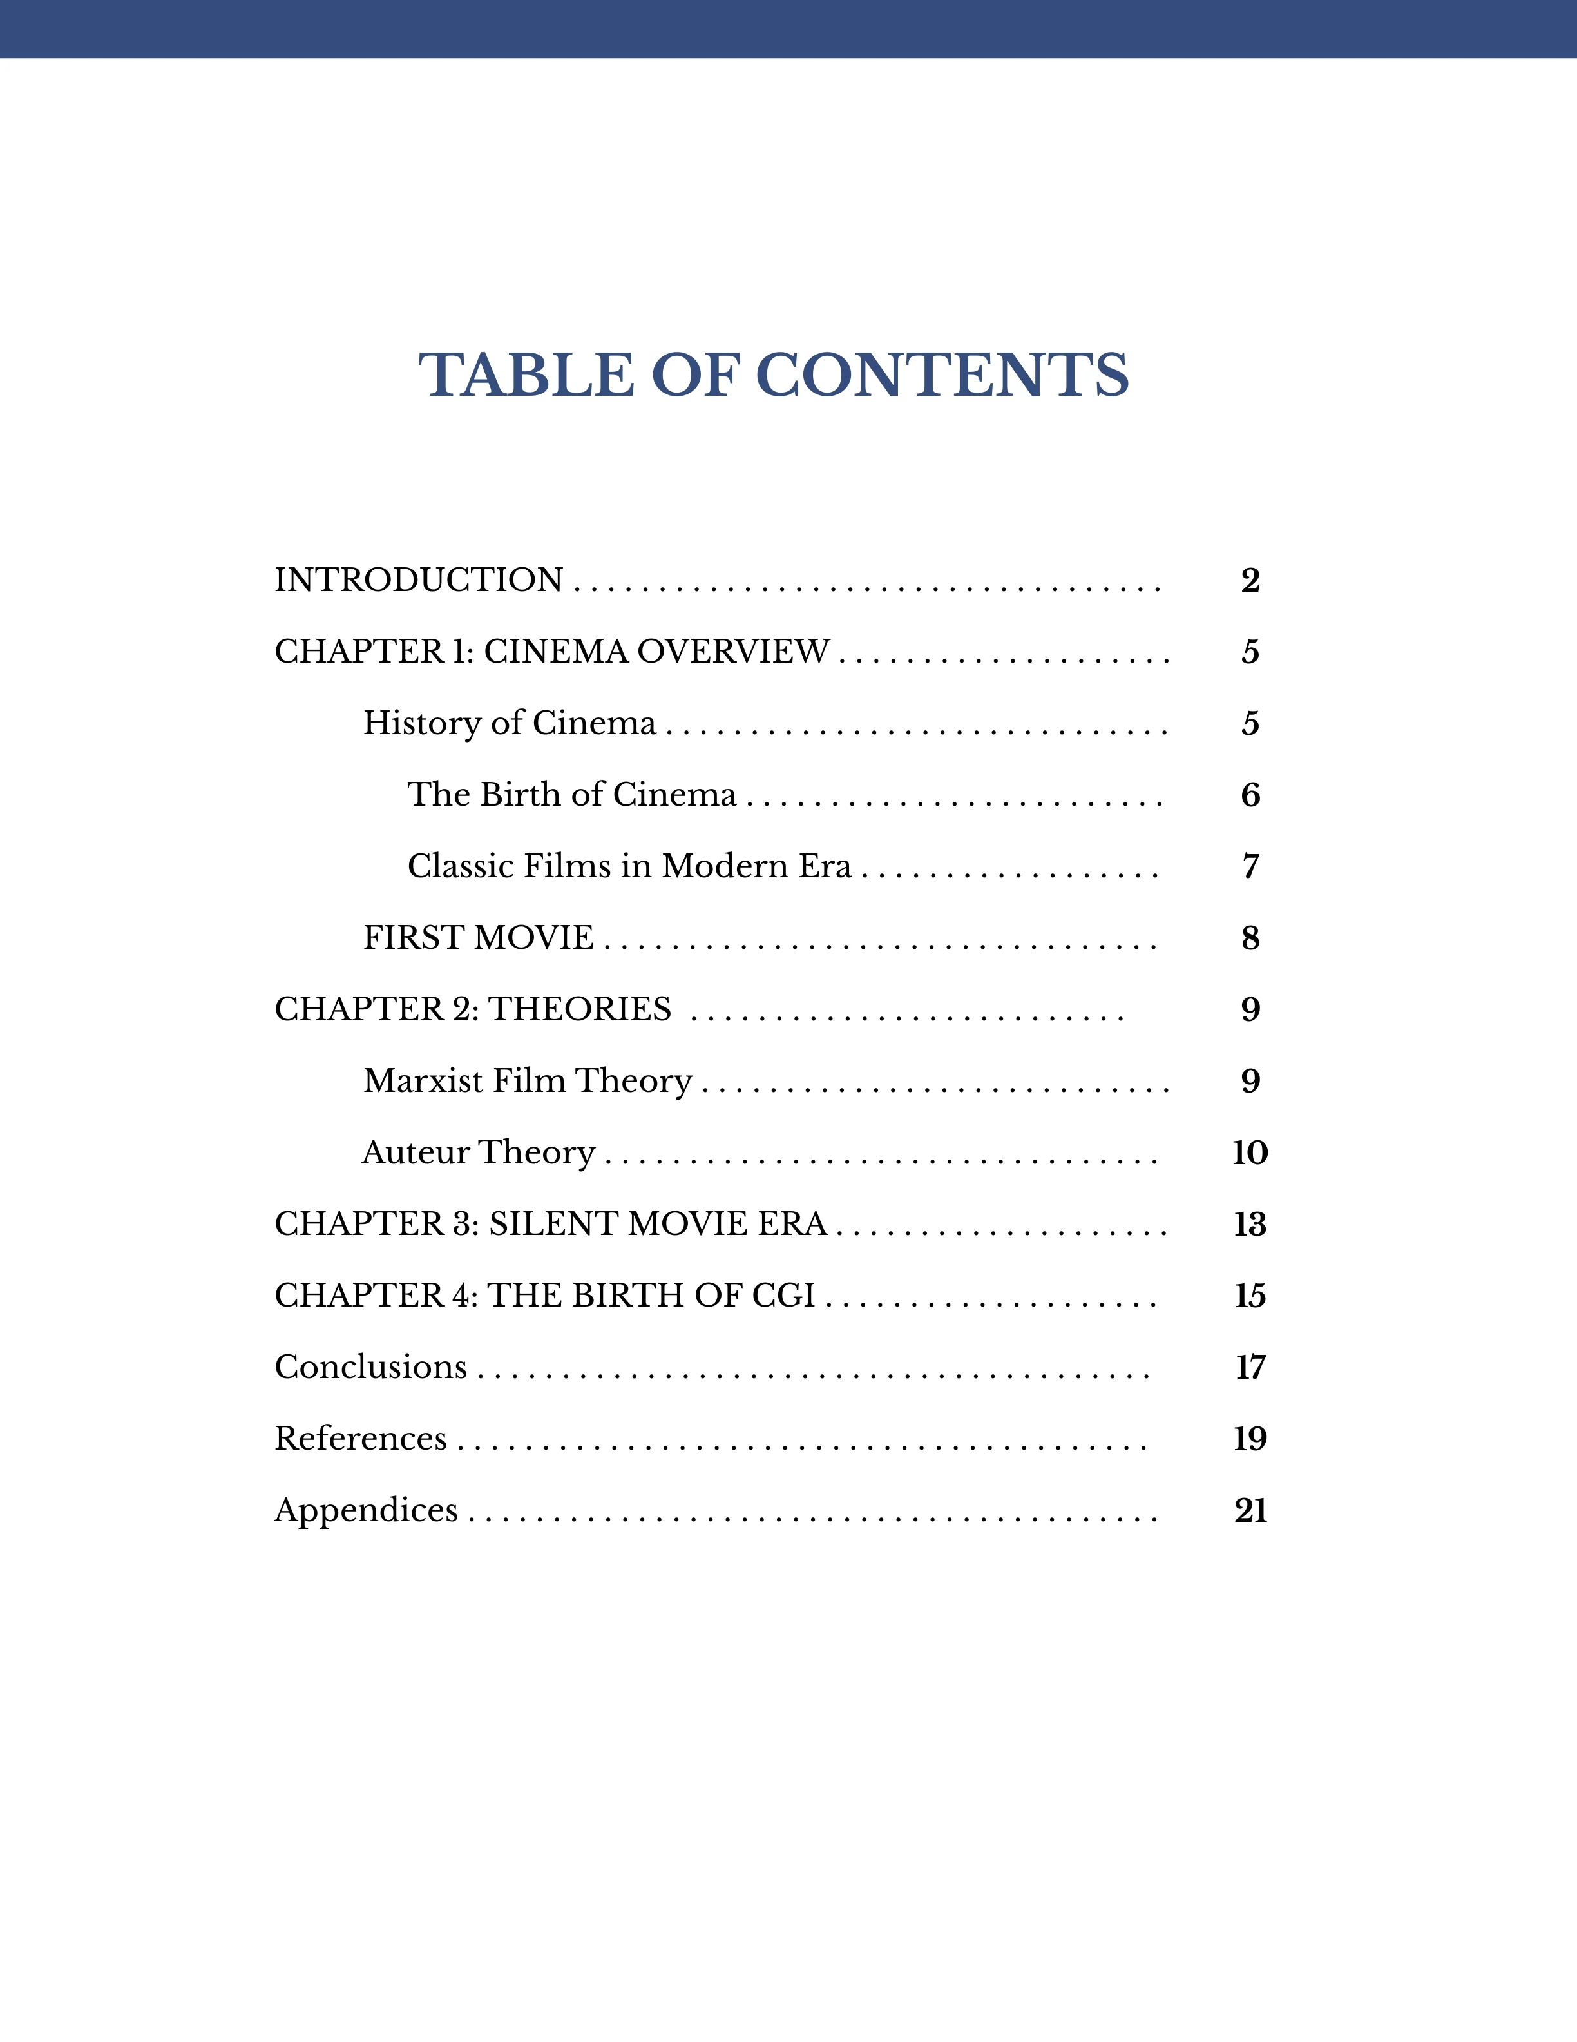
Table of Content

Slide 10
Introduction
Opening Statement
Hook/Lead
Thesis Statement
An introduction should establish the topic with a strong opening that grabs the reader's attention before giving an overview of recent research on your chosen topic. Avoid going too in-depth
Expresses the position that the rest of the paper will present evidence and arguments for. It can be presented in one or two sentences, and should state your position clearly and directly, without providing specific arguments for it at this point
Striking sentence that clearly conveys the relevance of your topic. E.g. The rise of social media has been accompanied by a sharp increase in the prevalence of body image issues among women and girls.

Slide 11
Opening Statement
Step 1
Step 2
Provide background: place to review previous research and establish how yours fits in
Step 3
Establish research problem: clarify how your own research fits in and what problem it addresses.
Step 4
Specify objective(s): specifics of what you intend to find out or express in your research paper
Step 5
Map your paper: brief overview of the rest of the paper
Topic Introduction: tell the reader about your topic & why it’s interesting or important. Can be accomplished with strong hook/lead

Slide 12

Research Paper - Body
Present supporting information effectively:
Vocabulary, tone, imagination, style, originality
Logical Development:
Make provisions for opposition of your topic
One paragraph to every major argument in support of your topic
Best arguments are often left for last.

Slide 13
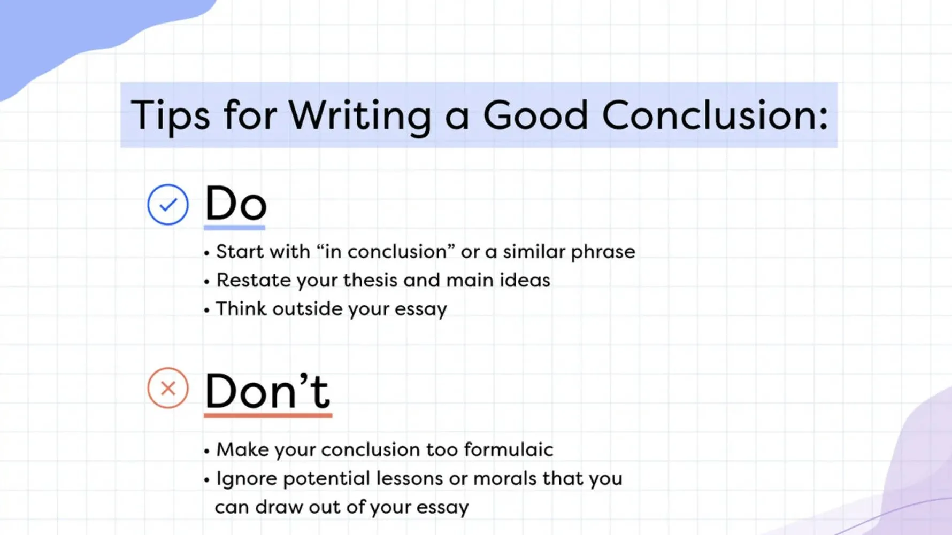
Conclusion

Slide 14
Steps to Effective Research writing
Clear, focused research question
Conduct a thorough literature review
Create research statement
Create strong outline
Begin first draft
Write compelling introduction
Abstract & Title are important
Conclusion – wrap up
Review and edit
Proper citations in-text and bibliography

Slide 15
Types of Sources: Primary
Provides a first-hand account of an event or time period and are considered to be authoritative.
They represent original thinking, reports on discoveries or events, or they can share new information. Often these sources are created at the time the events occurred, but they can also include sources that are created later. They are usually the first formal appearance of original research.
Examples:
diaries, correspondence, ships' logs, original documents - birth certificates, trial transcripts, biographies, autobiographies, manuscripts, interviews, speeches, oral histories, case law, legislation, regulations, constitutions, government documents, statistical data, research reports, a journal article reporting new research or findings

Slide 16
Types of Sources: Secondary
Require analysis, interpretation, or evaluation of the primary sources.
An attempt to describe or explain primary sources.
Often involve generalisation, interpretation, commentary or evaluation in an attempt to convince the reader of the creator's argument.
Examples: textbooks, dictionaries & encyclopedias, political commentary, newspaper editorial/opinion pieces

Slide 17

Research Proposal Structure
Problem
Knowledge gap that exist and needs to be explored
Objectives
The objectives that will help solve the identificed problem
Methodology
The approach that leads tro reaching the objectives
Resources
Resources/material needed to accomplish objective
Results & Impact
The new pkowledge that will be created and its real-world impact
Dissemination
Proper target audience and how you will reach them
Timeline
Time required to perform each part of the research project within the confines of the deadline

Slide 18
Assignment 1
Students will submit their research topic for approval along with their thesis statement, and significance of study. Students must clearly identify how their research will be beneficial and use the topic tips questions of – who, what, when, where, and why – to answer. Please note the previous slide on the structure of a research proposal.

